Slide 1
Long Flight Time Buoyant Drone
(LFTBD)
Presented by:
Dylan Harootunian
Notes:
Introduce ourselves (Name, Year, Major)

Slide 2
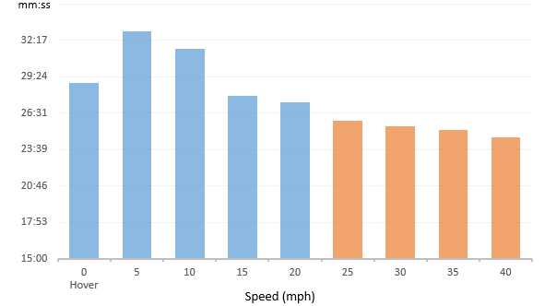
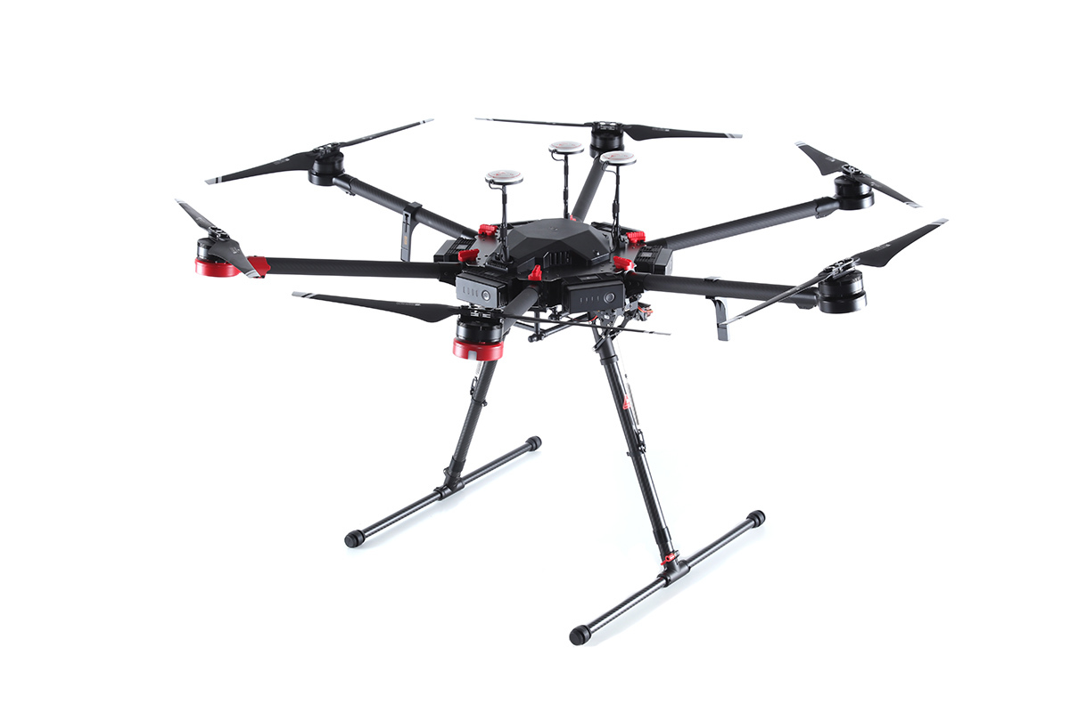
Problems of Modern Drones
Low Flight Time
Limited Range
Avg Minutes Per Battery of the DJI Matrice 600 from airdata.com. Which rates it as number 1 in terms of MPB, of the drones they collected data on
DJI Matrice 600
Source: store.dji.com
Notes:
Drones have blown up in popularity over the last few years due to a dramatic drop in price and are being used at higher rates, for casual photography as well as professional film and documentary making however they still are used in data collections at the rates that they could be.
Although drones are useful tools, they are heavy and have limited flight time and range. This is mainly due to their reliance on batteries to power propellers for lift. In addition most drones only have an operating range of a couple hundred feet which can be very limiting.
Most Typical drones have a flight time of 20-30 minutes
Even this best in class drone ( the DJI matrice 600) only has a flight time over just over 30 min in a study that took data from over 2 million flights from a variety of drones
Time to recharge battery is approximately 90 minutes

Slide 3
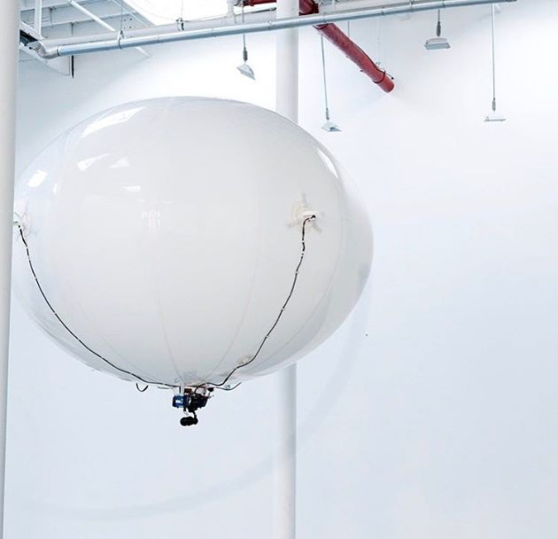
Benefits
Lighter than air systems are appealing since the energy required to keep them airborne is small.
Lighter than air drones spend the most energy moving and compensating for wind disturbances, rather than trying to keep themselves on air.
Does not need existing infrastructure.
Smaller batteries = smaller environmental impact
Source: uav.org
Notes:
In this project we hope to design a drone the employs a hydrogen lift bag to keep it buoyant relative to the surrounding air. This will allow the drone to only use energy to compensate for wind disturbances rather than keep the drone in the air.
(most of the porject will involve around simulating flight and figuring out how much more energy efficent this would really be, and how much longer we could get this drone to fly)
Other current long flight time drones require cable infrastructure to keep the drone charge, an issue with out drone will not have, so it can be deployed anywhere
Batteries have large environmental impacts, since our drone will need smaller batteries and use less energy the environmental impact will be much smaller
This is similar to the comparison to blimps being used to film sporting events instead of helicopters since they can stay in one spot for a long time at a much lower cost

Slide 4
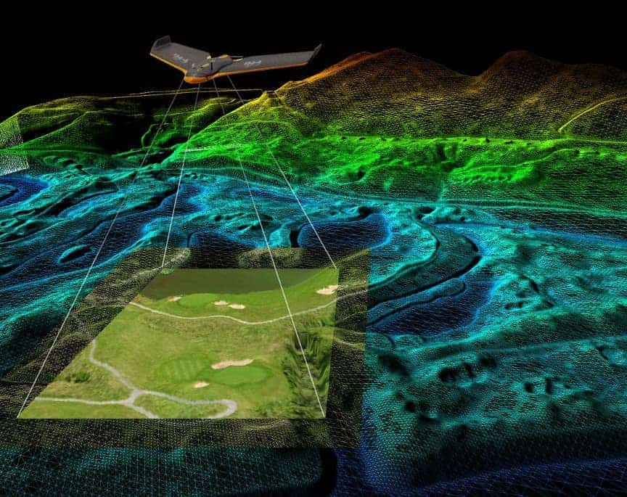
Possible Applications
Search and Rescue
Surveying Dangerous Areas
Air Quality Monitoring
Collecting Data Over Long Periods of Time
Aerial Topology
Hobbyist Photography
Source: droneanalyst.com
Notes:
Here we listed several possible applications of a long flight time drone. For example, if we equip the drone with an infrared sensor the drone can be used to attempt to catch possible fire hotspots. Or a traditional camera can be equipped for hobbyist use.

Slide 5
Potential Clients
Aerospace Companies:
SpaceX, Boeing, NASA, JPL, DJI
San Francisco
Firefighters
Civil Engineering
Surveyors
Researchers
Professor Elkaim
Notes:
These are some of the possible clients we have started to reach out to, we have yet to hear back from them but hope to finalize a client soon.

Slide 6
Possible Goals
Multi-hour flight time (primary)
Drone weight less than 30g
Modularity
Durability
Long Distance Communication (1 Mile)
Notes:
Long enough that another drone can be charged and sent to the same location before it has to return
At 30 grams the balloon will have to be around ⅓ meter which is a more manageable size compared to many balloon drone out there today
Can host different sensors to increase use cases
We think prioritizing the drones ability to send data over a long distances will assist the drones applications in dangerous areas.

Slide 7
Team Skills
Dylan Harootunian: CAD, UAV simulation, Embedded systems
Isaac Szu: PCB design, UAV simulation, Embedded Programming
Leon Shuster: Sensor Integration, Feedback Control, UAV simulation, Embedded Programming, Robotics Manipulation
Jeremy Germenis: Embedded Systems, Communication Systems & Signals, Power Consumption
Ryan Wong: PCB Design/ Simulation (Eagle CAD), Hardware debugging, Computer Logic Design
One additional member: Control Systems experience

Slide 8
Roles
Mechanical Design:
Dylan
Leon
Power Management:
Jeremy Isaac
Ryan
Flight Simulation(Vrep):
Isaac Leon
Jeremy Dylan
Systems Programming:
Leon Ryan
Dylan
Control Systems:
Leon
PCB design:
Ryan
Isaac

Slide 9
References
Y. Bestaoui Sebbane et al., Lighter than Air Robots, vol. 58. Dordrecht: Springer Netherlands, 2012.
“Drone Flight Stats - Part 1 | Airdata UAV Drone Blog,” airdata. [Online]. Available: https://airdata.com/blog/2017/drone-flight-stats-part-1.

Slide 10
Any Questions?
Information meeting at : 7PM Tonight
Zoom Link: https://ucsc.zoom.us/j/95464033378?pwd=Y3cxdFZWbjR0Tm82azFWQjRrQjJ1QT09
Email: dhharoot@ucsc.edu
We are looking for one additional member

